Slide 1

Methods of Resource Scheduling Based on Optimized in Fog Computing
Presented by
Abdur Rashid Md Emon Shaikh Roll No-1418018 Roll No-1418050

Slide 2
Contents
Introduction
Application
Architecture
Implementation
Resource Scheduling
Propose different types of scheduling
Propose of Combine Scheduling
Implementation scheduling
Graphical Represent of Combine scheduling

Slide 3
Introduction
The so-called IoT(Internet of Thing) emcompasses a range of internet-capable device that cloud be anything.
Fog= Internet of Thing + Cloud
Fog computing is a model in which data ,processing and application Concentrated in device at the network edge rather than existing almost entirely in the cloud.
The concentration means that data can be processed locally smart device rather than being sent to the cloud for processing.

Slide 4
Application of Fog
Geographically distributed application
Fast mobile application
Large-scale distributed control systems

Slide 5
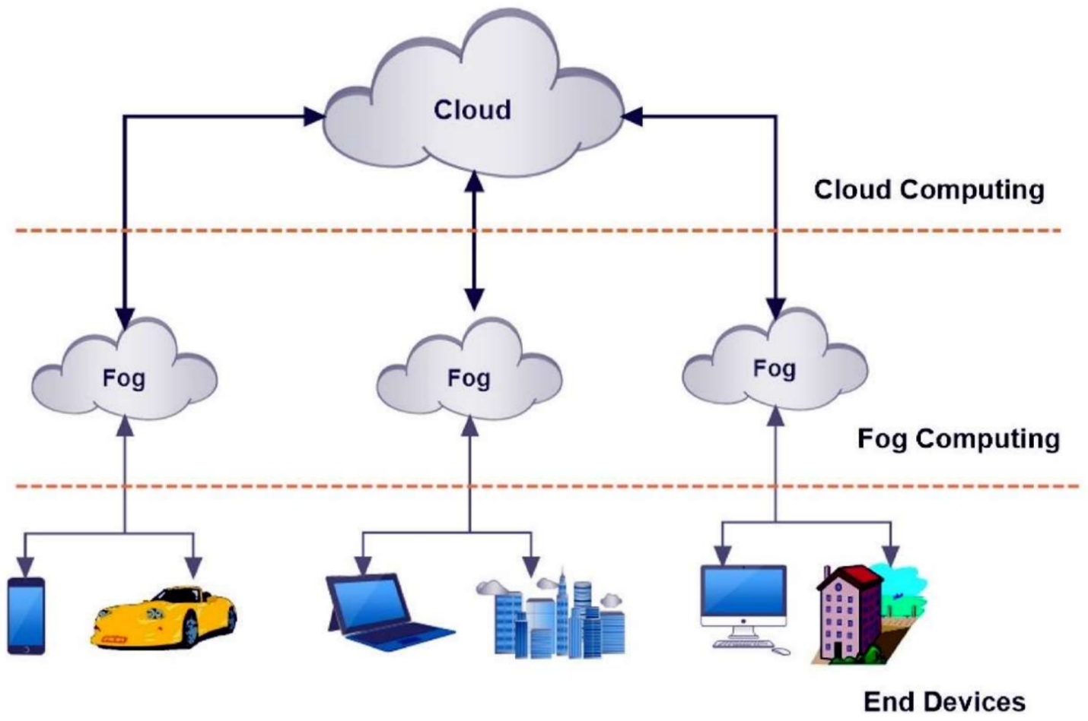
Architecture of Fog computing

Slide 6
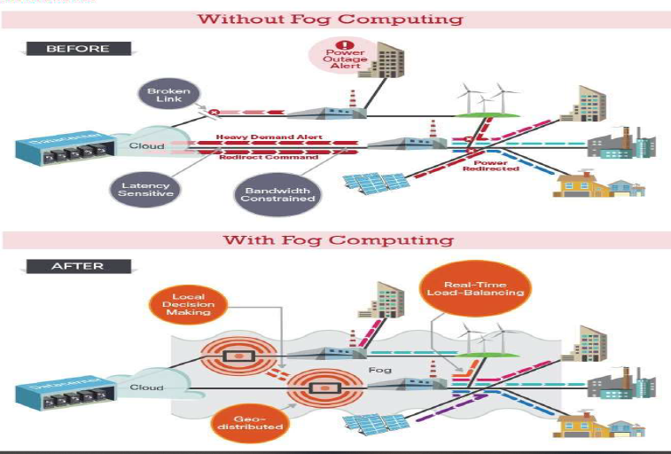
Implementation of Fog Computing

Slide 7
Resource Scheduling
Definition : Resource scheduling is a collection of techniques used to calculate the resources required to deliver the work and when they will be required.
The resource scheduling process has three steps:
Allocation : Allocation involves identifying what resources are needed to complete the work.
Aggregation : The aggregated data is usually presented in a histogram that illustrates the fluctuating use of resources against time.
Scheduling : different types of scheduling we discuss that,

Slide 8
CPU Scheduling
First Come First Served Scheduling
Round Robin Scheduling
Priority Scheduling

Slide 9
First Come First Served Scheduling
First in, first out (FIFO), also known as first come, first served (FCFS), is the simplest scheduling algorithm. FIFO simply queues processes in the order that they arrive in the ready queue.
In this, the process that comes first will be executed first and next process starts only after the previous gets fully executed.

Slide 10
FCFS CPU Scheduling Example
Proces | Brust time
P1 | 21
P2 | 3
P3 | 6
P4 | 2

Slide 11
Round Robin Scheduling
Round Robin is a CPU scheduling algorithm where each process is assigned a fixed time slot in a cyclic way.
It is simple, easy to implement, and starvation-free as all processes get fair share of CPU.
One of the most commonly used technique in CPU scheduling as a core.
It is preemptive as processes are assigned CPU only for a fixed slice of time at most.
The disadvantage of it is more overhead of context switching.

Slide 12
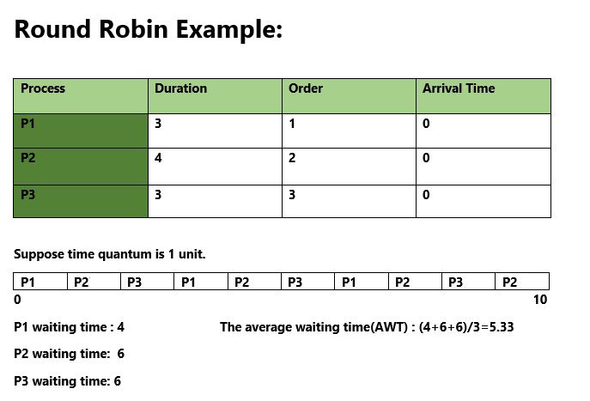
Round Robin Example

Slide 13
Program for Priority CPU Scheduling
Priority scheduling is one of the most common scheduling algorithms in batch systems. Each process is assigned a priority. Process with the highest priority is to be executed first and so on.
Processes with the same priority are executed on first come first served basis. Priority can be decided based on memory requirements, time requirements or any other resource requirement.

Slide 14
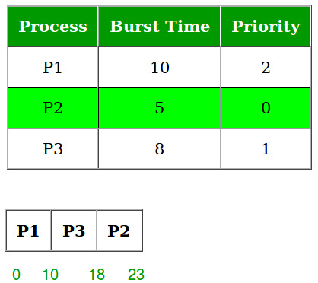
Priority tesk scheduling

Slide 15
Implementation of combined Scheduling

Slide 16

Question

Slide 17
Any Question

